Slide 1
Healthy Churches avoid worldliness
(PART 3: INVESTMENTS)
1 Timothy 6:17-21
Preached by Dr. Jim Harmeling at Crossroads International Church Singapore • cicfamily.com Uploaded by Dr. Rick Griffith • Singapore Bible College Thousands of files in 49 languages for free at BibleStudyDownloads.org

Slide 2
Healthy Church Life
Studies in 1 Timothy

Slide 3
Healthy Churches
Guard the gospel message (1)
Pray (2)
Develop godly leaders (3)
Discern truth from error (4)
Honor each other (5)
Avoid worldliness (6)

Slide 4
They are content with the Lord’s provision
(1 Timothy 6:3-10)

Slide 5
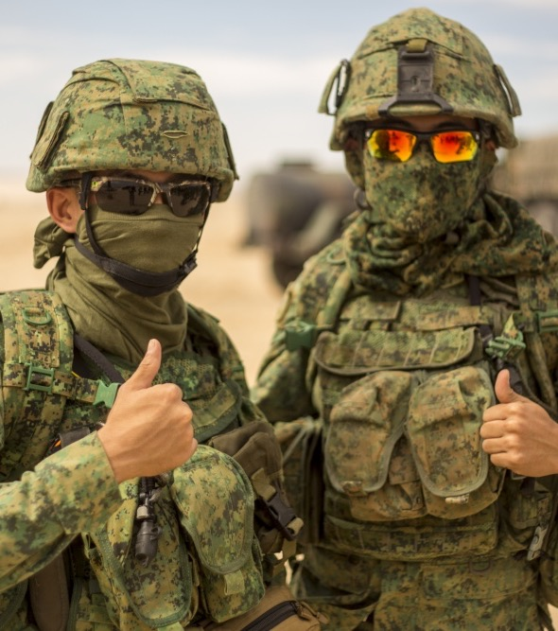
They persevere in the battle against worldliness
(1 Timothy 6:11-16)

Slide 6
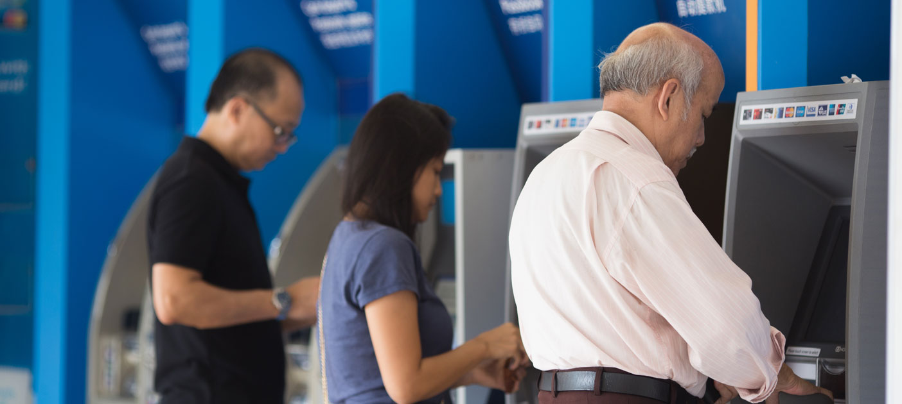
They richly invest in the eternal state
(1 Timothy 6:17-21)

Slide 7
Matthew 13:45-46
⁴⁵ “Again, the kingdom of heaven is like a merchant in search of fine pearls, ⁴⁶ who, on finding one pearl of great value, went and sold all that he had and bought it.”

Slide 8
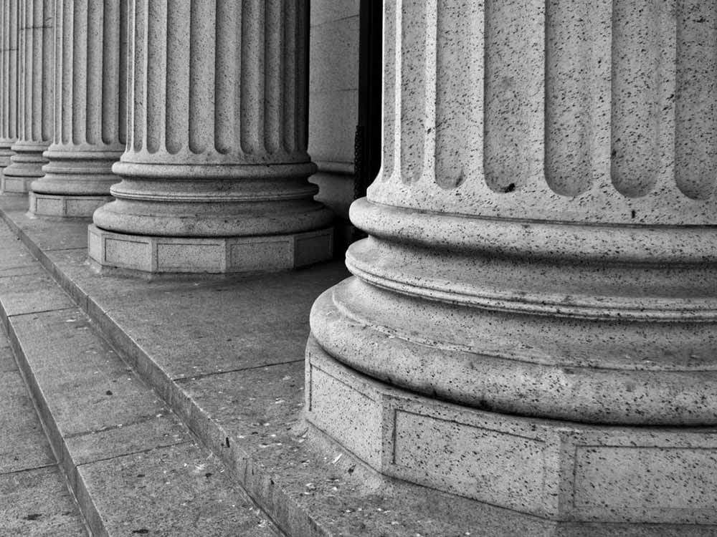
Trust in God’s future life instead of this life (1 Tim 6:17-19)
Guard against a proud mindset (v. 17)
Proverbs 23:4-5
“Do not toil to acquire wealth; be discerning enough to desist. ⁵ When your eyes light on it, it is gone, for suddenly it sprouts wings, flying like an eagle toward heaven.”

Slide 9
Trust in God’s future life instead of this life (1 Tim 6:17-19)
Guard against a proud mindset (v. 17)
Matthew 6:19-21
¹⁹ “Do not lay up for yourselves treasures on earth, where moth and rust destroy and where thieves break in and steal, ²⁰ but lay up for yourselves treasures in heaven, where neither moth nor rust destroys and where thieves do not break in and steal. ²¹ For where your treasure is, there your heart will be also.”

Slide 10
Haggai 2:8
“The silver is mine, and the gold is mine, declares the Lord of hosts.”
1 Corinthians 4:1-2
“This is how one should regard us, as servants of Christ and stewards of the mysteries of God. ² Moreover, it is required of stewards that they be found faithful.”

Slide 11
Trust in God’s future life instead of this life (1 Tim 6:17-19)
Guard against a proud mindset (v. 17)
Develop eternal investment mindset (vs. 18-19)
“do good”
“rich in good works”
“generous and ready to share”

Slide 12
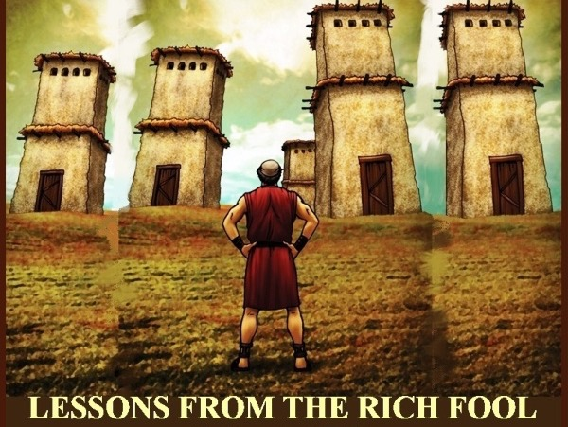

Slide 13
Trust in God’s future life instead of this life (1 Tim 6:17-19)
Remain true to God’s revelation instead of world’s values
(1 Tim 6:20-21)

Slide 14
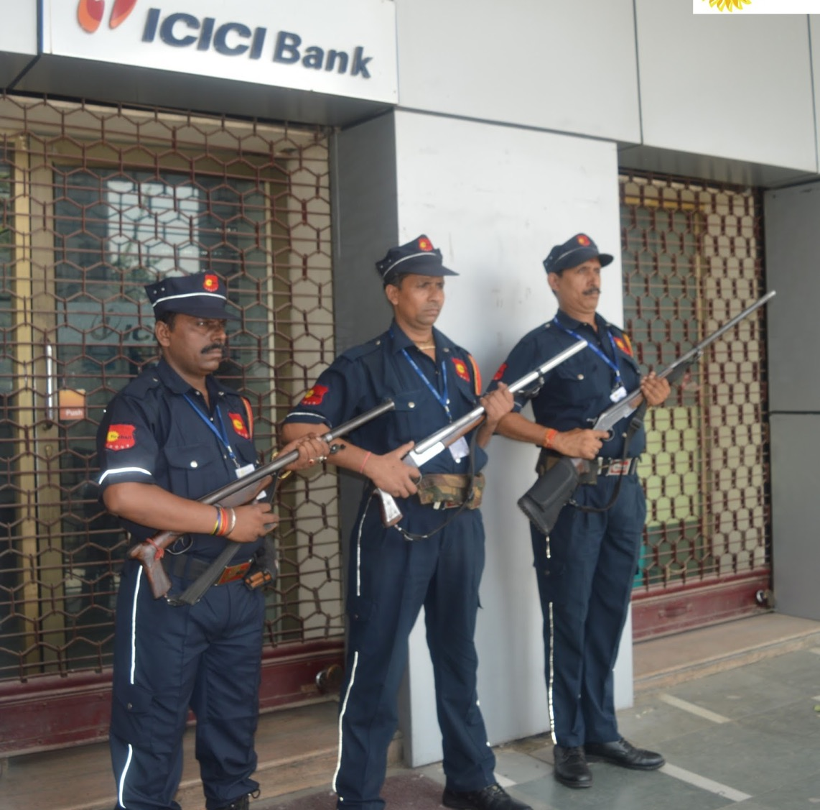
Guard the deposit

Slide 17
NT Preaching • BibleStudyDownloads.org
Get this presentation for free!

